Slide 1
Catholic Health Pharmacy APPE Longitudinal Program
Kelsey Gregoire, PharmD, MPH, BCCCP

Slide 2
A brief history of Catholic Health
Catholic Health founded 1998
Sisters of Charity – 1848 by the Daughters of Charity of St. Vincent de Paul
Mercy Hospital of Buffalo – 1904 by the Sisters of Mercy
Mount St Mary’s Hospital – 1907 by the Sisters of St. Frances of Williamsville
Kenmore Mercy Hospital – 1951 by the Sisters of Mercy
St Joseph Hospital – 1960 by the Franciscan Sisters of St. Joseph
Merged with SOCH in 2009
Lockport Memorial Hospital – 2023
Total Acute Care Beds = 1069
Outpatient facilities
> 50 facilities across 8 counties in WNY

Slide 3
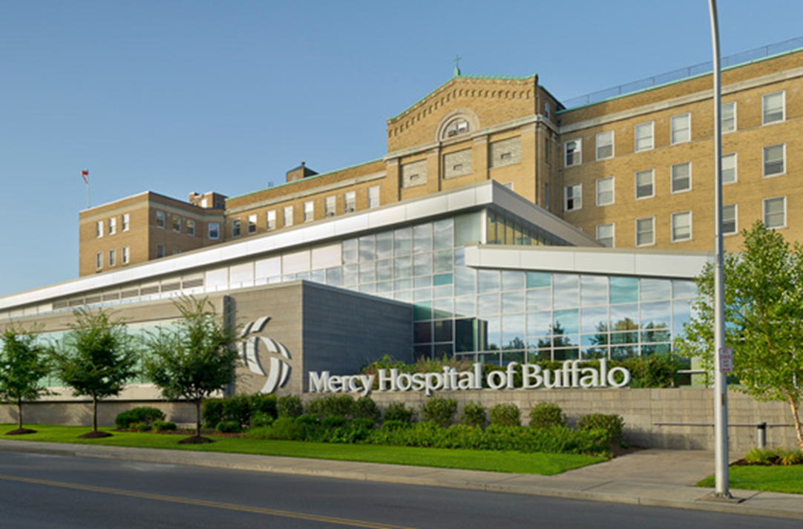
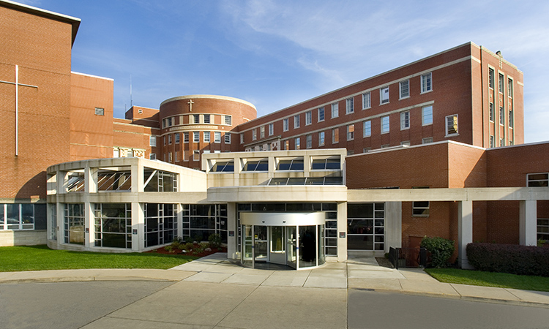
Hospitals
Mercy Hospital of Buffalo
387-bed community teaching hospital
One of the busiest emergency rooms in WNY caring for >75,000 patients annually
Specializes in cardiac surgery and neurology
Sisters of Charity Hospital
310 bed community teaching center
Specialized in maternity/neonatal care, vascular surgery and bariatrics

Slide 4
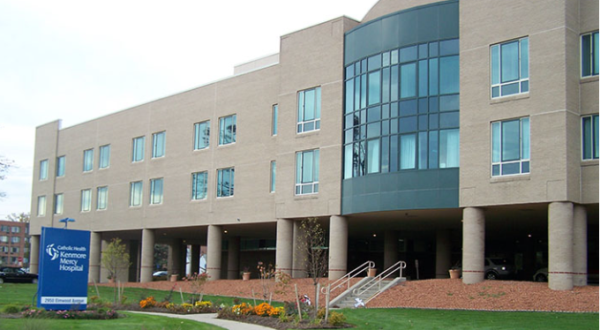
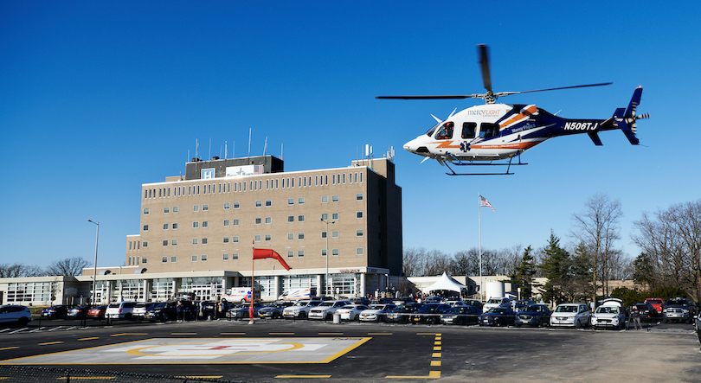
Hospitals (continued)
Kenmore Mercy Hospital
185-bed hospital
Specialized in ambulatory surgery and infectious diseases
Mount St Mary’s
Small community hospital that serves Lewiston and Greater Niagara Falls area
Clearview Treatment Services
69-bed inpatient chemical dependency unit
28-day inpatient treatment for alcohol, prescription drug, cocaine and heroin addiction

Slide 5
Catholic Health Residency Programs
PGY-1 Pharmacy Practice Residency
RPD: Tim Vink, PharmD, BCPS
Mercy (4)
Sisters of Charity (3)
PGY-2 Emergency Medicine
RPD: Alyssa Kiel, PharmD, BCPS, BCEMP
Mercy (1)
PGY2 Ambulatory Care
RPD: Kara Wilcox, PharmD, MBA, BCACP
Sisters of Charity Clinics (1)

Slide 6
CHS Longitudinal Program
16 week total experience
Rotation Type | Duration | Student Experience
Hospital Health Systems Pharmacy | 4 weeks | Compounding Order verification Dispensing medications
Inpatient Care: Adult Patient Care | 6 weeks | Interdisciplinary Rounds Medication history reconciliation Pharmacokinetic monitoring Anticoagulation monitoring Drug information questions Patient counseling
Inpatient Care: Electives | 6 weeks | TBD based on rotation selected

Slide 7
Rotation Specifics
Hospital Health Systems Pharmacy (Core) (4 weeks)
Inpatient Care: Adult Patient Care (Core) (6 weeks)
Internal Medicine
Intensive Care
Electives – Direct Patient Care (6 weeks):
Can chose an additional core rotation
Infectious Disease
Psychiatric Pharmacy
Emergency Medicine
Ambulatory Care
Administrative at Mercy (Dual PharmD/MBA students preferred)
Clinical Pharmacy Specialists:
Internal Medicine
Critical Care
Infectious Disease
Emergency Medicine
Ambulatory Care
Behavioral Health
All preceptors have board certification(s)

Slide 8
Student Requirements
Application through UB SPPS
Letter of intent
CV
Interview (In-person preferred if able)
CV and letter of intent should be attached to UB Application. Kris Jordan will forward along to Kelsey Gregoire at Kgregoire@chsbuffalo.org and CC Tim Vink at tvink@chsbuffalo.org
Student scheduling will be completed based on preceptor availability and student interest areas

Slide 9
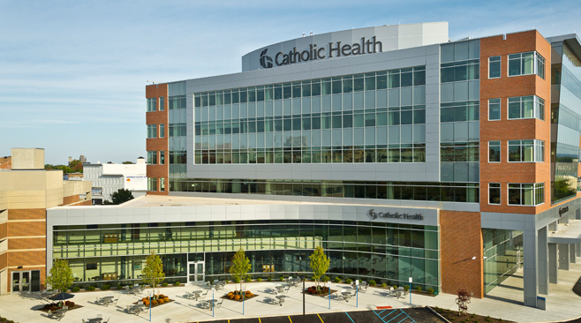
Questions
Email Kelsey Gregoire at Kgregoire@chsbuffalo.org

